Slide 1
Core Stability
This presentation will help staff:
Understand what core stability is
Know how you might notice if someone is having difficulties with their core stability
Select activities to support those who are having difficulties with their core stability

Slide 2
About Core Stability
Core strength comes from trunk muscles and it enables us to develop posture for movement and anti-gravity positioning.
Core stability is required for most movement based control over the body including head control, upper limb control and mobility.
It gives us balance, enables effective bilateral skills and the ability to stabilise joints for the use of tools such as a pencil.
Core stability is required to enable shoulder stability which then enable upper limb stability and then hand skill development.

Slide 3
Challenges with Core Stability
Reduced core stability can be the result of low tone and this can be seen in various positioning:
Leaning on furniture or tables
Holding breath during tasks
Wrapping the limbs around furniture to stabilise
Leaning on peers
Sinking into furniture
Reduced strength in hand grips
Fatigue
Poor balance
Climbing difficulties
Reduced engagement in physical activity
Anxiety with balance challenges

Slide 4
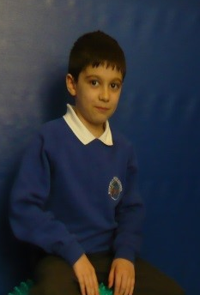
Activities to Support
Sitting on a wobble cushion on a chair and at floor time.
Sitting on an unstable surface promotes activation of core muscles for seated tasks, therefore increasing core muscles.

Slide 5
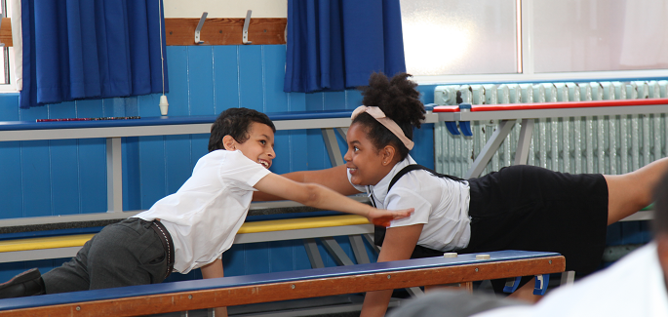
Activities to Support
Floor activities:
Bridging
4-point kneeling and
Raising opposite arm and leg
These will increase core strength

Slide 6
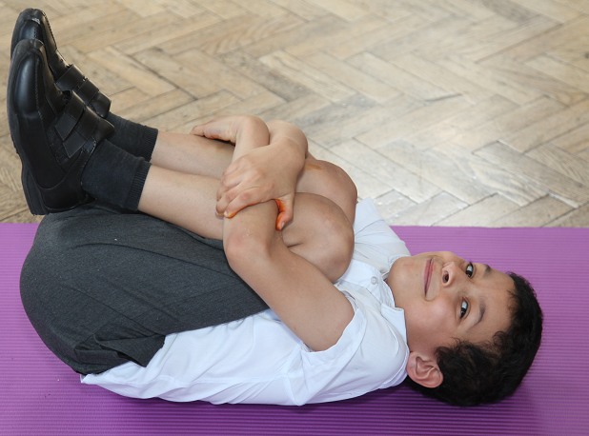
Activities to Support
Lying on backs and curling into a ball
This increases flexor muscle strength.

Slide 7
Activities to Support
Chair push ups
wall push ups
4-point kneeling push ups
These will increase shoulder and upper limb strength and increase awareness of upper body.

Slide 8
Activities to Support
Balance beanbag on head and crouch down to touch the floor
This will promote a good posture.

Slide 9
Activities to Support
Holding a “Plank position is very good for core stability.
Use with older pupils.

Slide 10
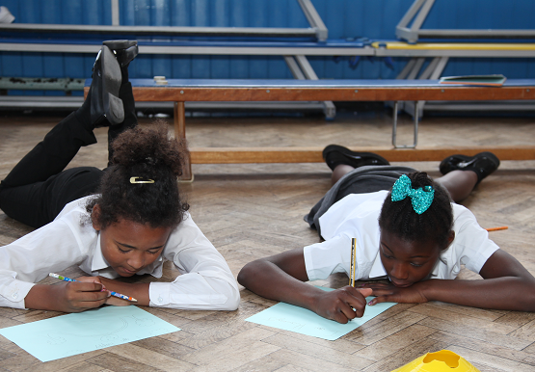
Activities to Support
Activities completed on tummies such as reading
This will increase back extensor strength

Slide 11
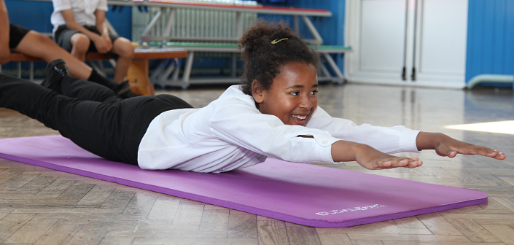
Activities to Support
Lying on tummy and assuming superman position
This increases back extensor strength

Slide 12
Activities to Support
Sitting on a gym ball and balancing, then leaning back while walking feet forward (older children)
This is much like a stomach crunch activity and will increase core strength.

Slide 13
Activities to Support
On tummy over gym ball and holding a straight body position
This increases back strength and upper limb weight bearing.

